Slide 1
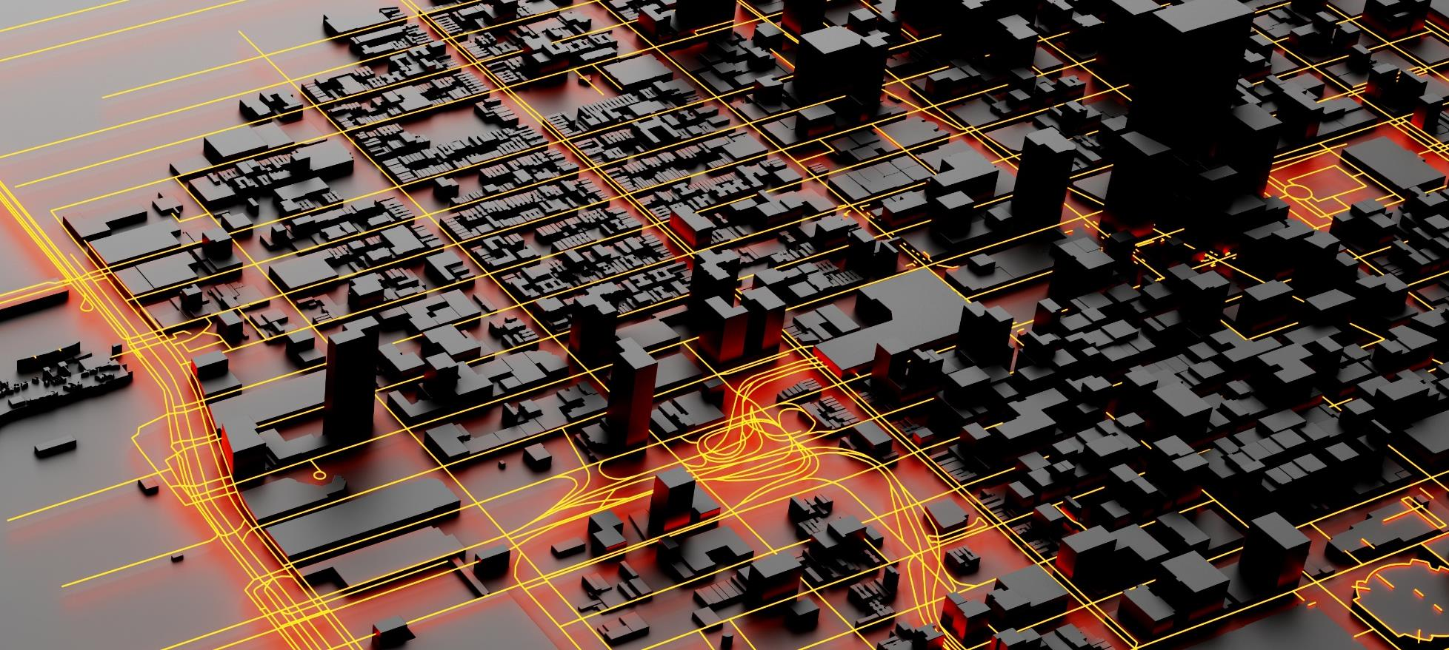
REIMAGINING PINE AVENUE

Slide 2
Direction from last Meeting and Objective of this Meeting
PARKING
ALTERNATIVES UPDATE
If parking is taken off Pine Ave. where big trucks will park?
How many parking spaces will be eliminated along Pine Ave?
Different Alternatives
Changes from Original
Pros and Cons
Opinion of Probable Cost
TRAFFIC ANALYSIS
100+ Local Dedicated Staff
TRAFFIC ANALYSIS
What is the adjusted traffic for peak season?
If one-way pairs is implemented how this will increase traffic on other streets?
Notes:
Mark

Slide 3
PARKING
Notes:
Gery

Slide 4
EXISTING PARALLEL PARKING ALONG PINE AVENUE
Parking spaces were determined utilizing the standard dimensions for parallel parking of 8’ x 20’
Pine Avenue East Side
N. Shore to 305 Pine Avenue – 5 spaces
305 Pine to Crescent Drive – 1 space
Near Beach Bums Rentals – 4 spaces
Near AMI General Store – 6 spaces
In Front of Roser Church – 3 spaces
In front of post office – 2 spaces
TOTAL SPACES – 21 Spaces
Pine Avenue West Side
From City Pier Park to Roser Church – 4 spaces
Front of Roser Church – 12 spaces
From Tarpon to Front of Pineapple Store – 2 spaces
From Tarpon to Gulf Drive – 13 spaces (not counting private spaces)
TOTAL SPACES – 31 Spaces
Independently of the alternative selected, we recommend the elimination of a total of
At least 19 spaces due to issues with sight distance blockage at driveways and side streets.
Notes:
Antonio

Slide 5
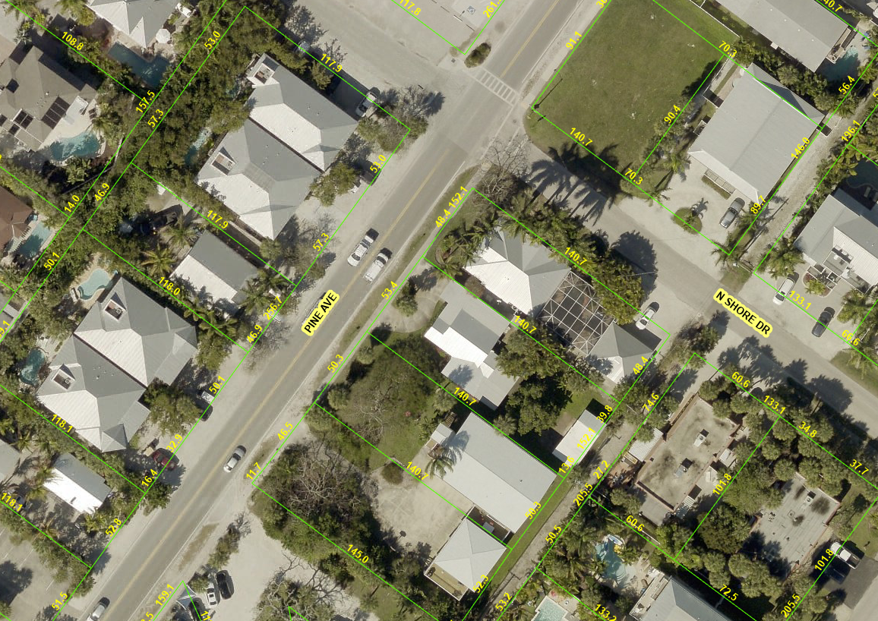
EXISTING PARALLEL PARKING RECOMMENDED FOR REMOVAL
Notes:
Antonio

Slide 6
TRAFFIC ANALYSIS
Notes:
Gery

Slide 7
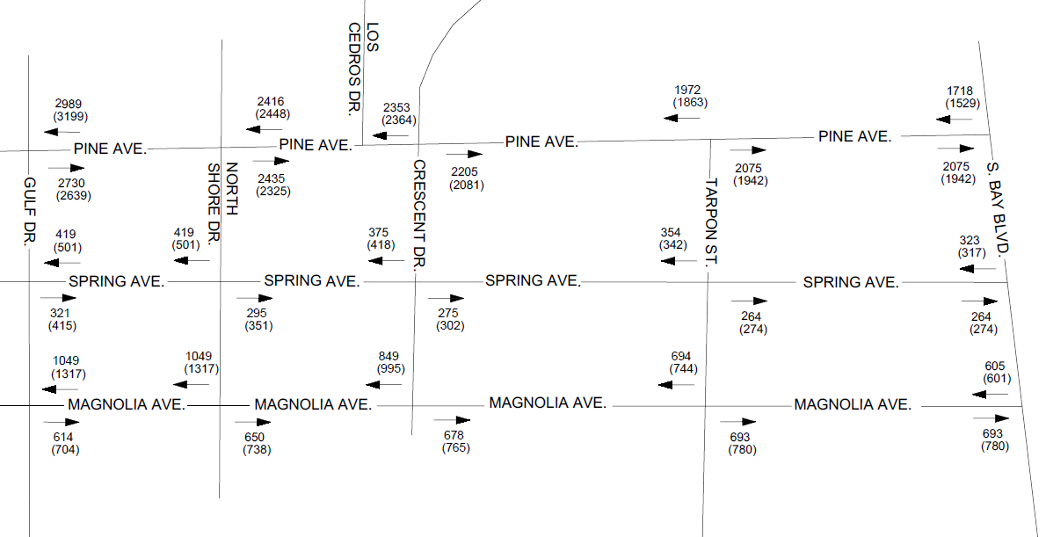
EXISTING TRAFFIC COUNTS – RAW DATA
XXX – Weekday (YYY) – Weekend
Notes:
Antonio

Slide 8
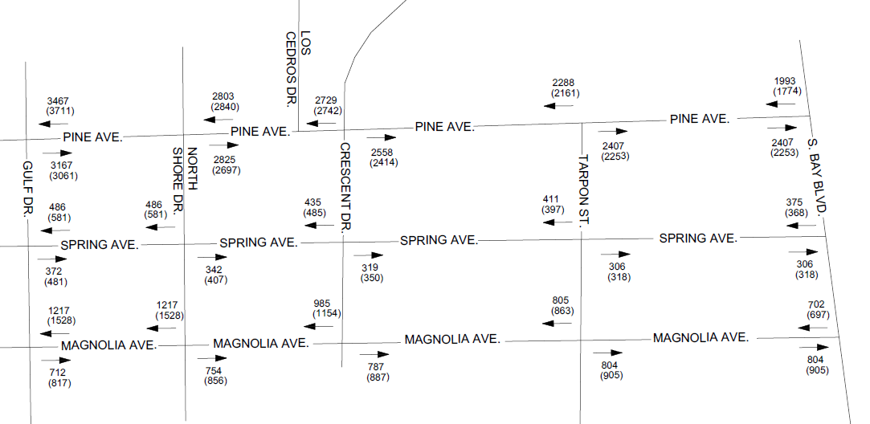
ADJUSTED TRAFFIC COUNTS PER PEAK SEASON FACTOR (16%)
XXX – Weekday (YYY) – Weekend
Notes:
Antonio

Slide 9
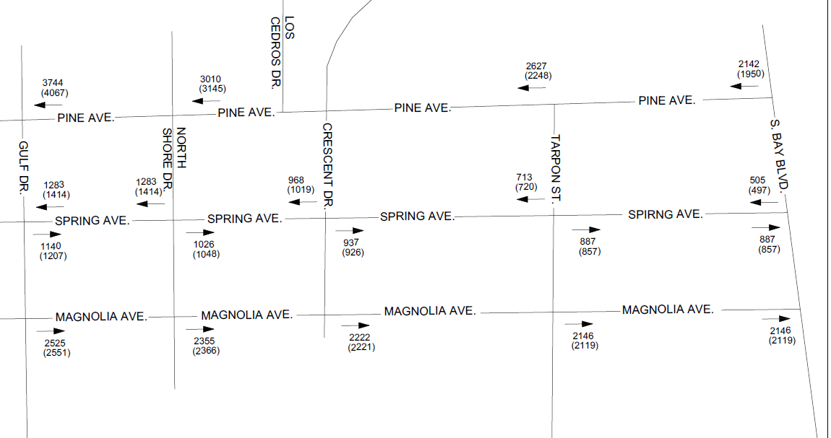
ONE-WAY TRAFFIC DISTRIBUTION
XXX – Weekday (YYY) – Weekend
Notes:
Antonio

Slide 10
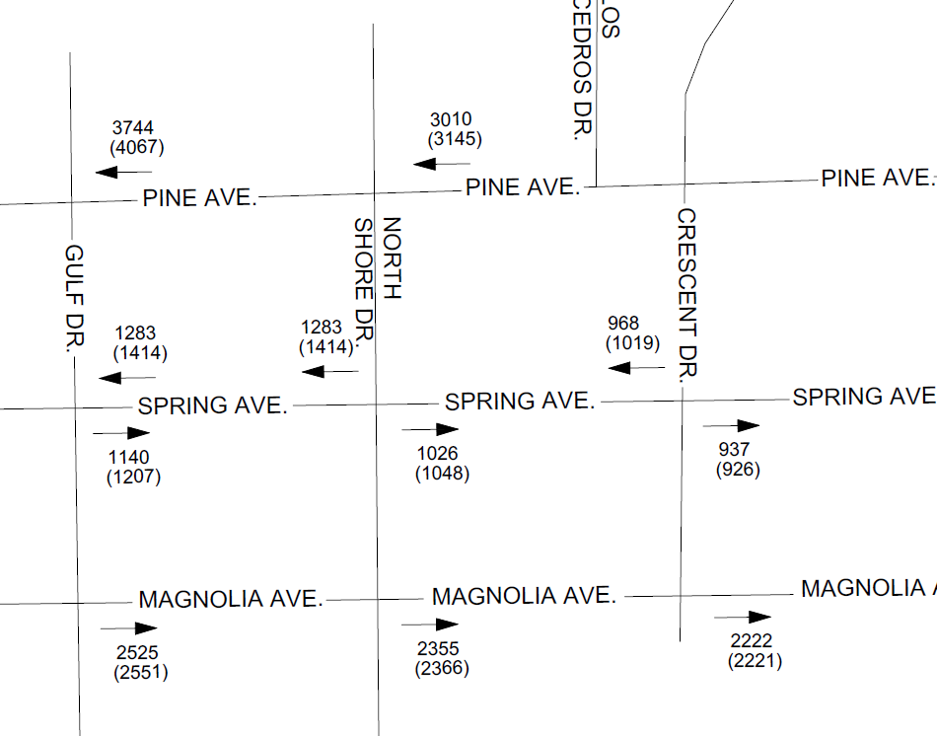
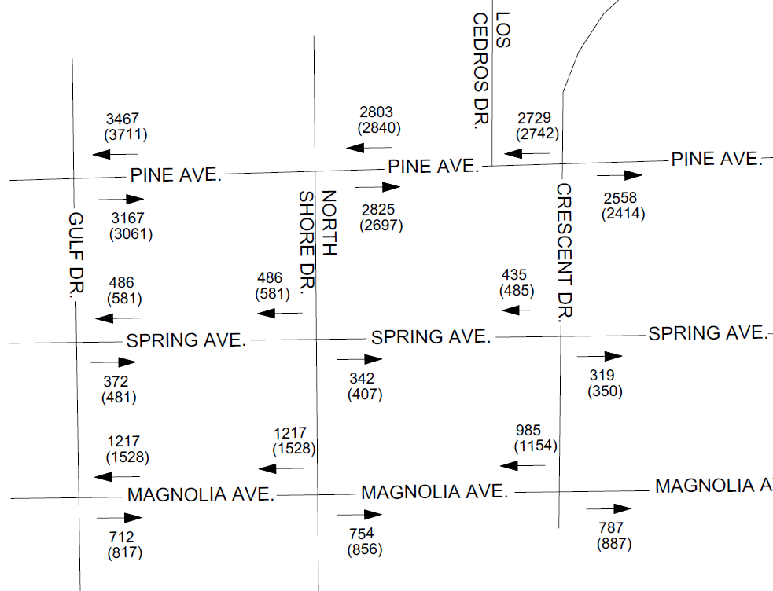
TRAFFIC COMPARISON – ADJUSTED TRAFFIC VS. ONE-WAY TRAFFIC
XXX – Weekday (YYY) – Weekend
ADJUSTED TRAFFIC COUNTS
ONE-WAY TRAFFIC DISTRIBUTION
Notes:
Antonio

Slide 11
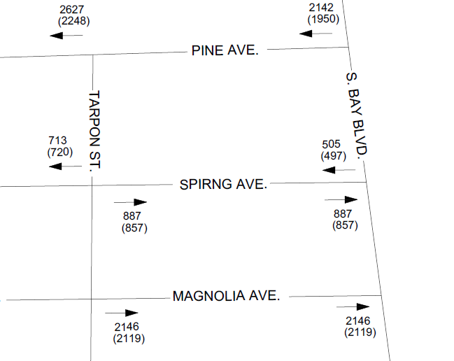
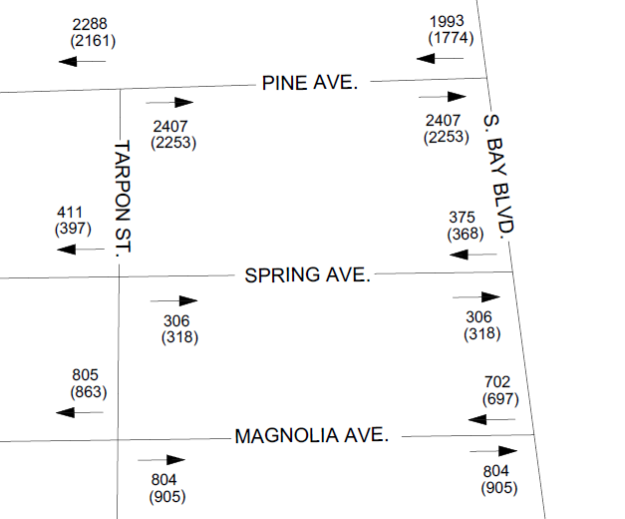
TRAFFIC COMPARISON – ADJUSTED TRAFFIC VS. ONE-WAY TRAFFIC
XXX – Weekday (YYY) – Weekend
ADJUSTED TRAFFIC COUNTS
ONE-WAY TRAFFIC DISTRIBUTION
Notes:
Antonio

Slide 12
ALTERNATIVES UPDATE
Notes:
Gery

Slide 13
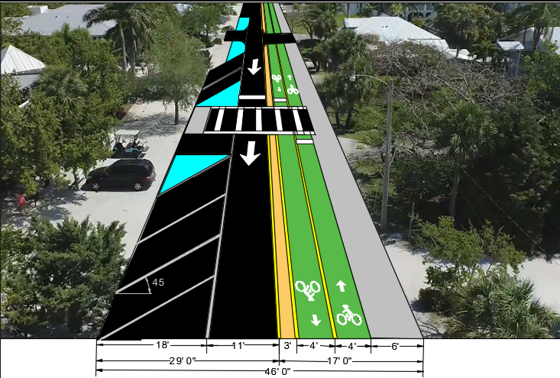
ALTERNATIVES 5
Convert Pine Avenue and Magnolia Avenue as one-way streets, with Sidewalks, On-Street Parking/Delivery, Multi-use Path & Ped Crosswalks
Notes:
Antonio

Slide 14
ALTERNATIVE #5 – Same as #1 plus adding buffered bike lanes and Sidewalks
PROS
Provides a separate facility for Bicyclists
Improved safety for Pedestrians by providing a continuous sidewalk.
Improved safety for Bicyclist by providing a buffer between vehicles and bicyclists.
Can increase the use of bicycles resulting in less congestion
Provides on Street Parking
Potential signalization of Magnolia at Gulf Drive
CONS
Traffic along Spring and Magnolia is projected to increase 350 to 400%
Increase in truck traffic along Spring and Magnolia
Can increase the operating speed of the one-way street creating some safety concerns
Most Expensive alternative with longest implementation time.
Notes:
Antonio / Nipper

Slide 15
TRAFFIC COMPARISON – ADJUSTED TRAFFIC VS. ONE-WAY TRAFFIC
XXX – Weekday (YYY) – Weekend
ADJUSTED TRAFFIC COUNTS
ONE-WAY TRAFFIC DISTRIBUTION
Notes:
Antonio

Slide 16
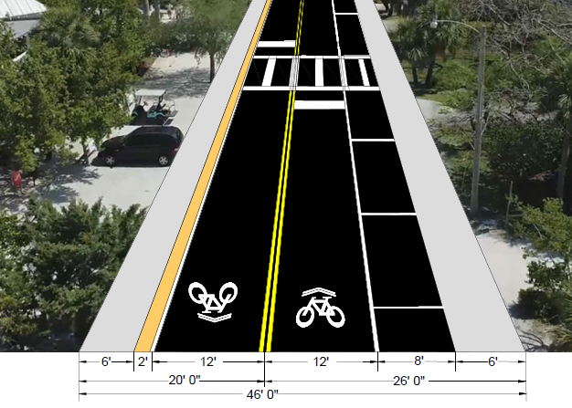
ALTERNATIVES #4
Add On-Steet Parking/Delivery Area, Sidewalks on Both Sides & Ped Crosswalks
Notes:
Antonio

Slide 17
ALTERNATIVE #4 – Add on-street parking/delivery parking, sidewalk and ped crossings
PROS
Provides on-street parking
Provides area for delivery vehicles to park out of the travel lane.
Improved safety for Pedestrians by providing a continuous sidewalk
CONS
Will not provide a separate facility for bicycles
May limit the use of bicycles
May further impact the operation of Pine Avenue due to bikes mixed with vehicular traffic.
Safety concerns of having vehicular traffic mixed with bicycle trips.
Notes:
Antonio / Nipper

Slide 18
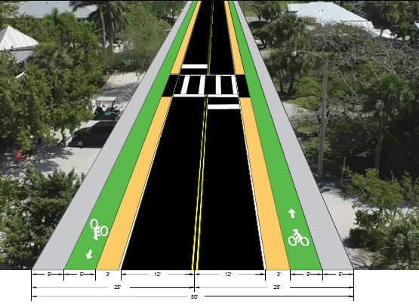
ALTERNATIVES #2
Add Buffered Bike Lanes and Sidewalks on Both Sides & Ped Crosswalks
Notes:
Antonio

Slide 19
ALTERNATIVE #2 – Same as #1 plus adding buffered bike lanes and Sidewalks
PROS
Provides a separate facility for Bicyclists
Improved safety for Pedestrians by providing a continuous sidewalk.
Improved safety for Bicyclist by providing a buffer between vehicles and bicyclists.
Can increase the use of bicycles resulting in less congestion
Potential for additional water quality treatment through the use of exfiltration trench with a valley gutter and inlets.
Use of regular concrete for sidewalk and bike lanes will reduce the cost
CONS
Will Eliminate 33 existing on-street parking spaces along Pine Avenue
Notes:
Antonio / Nipper

Slide 20
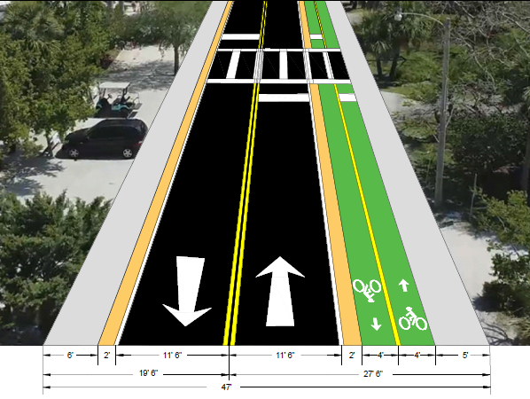
ALTERNATIVES #3
Add Multi-use Path, Sidewalks on Both Sides & Ped Crosswalks
Notes:
Antonio

Slide 21
ALTERNATIVE #2 – Same as #1 plus adding buffered bike lanes and Sidewalks
PROS
Provides a separate facility for Bicyclists
Improved safety for Pedestrians by providing a continuous sidewalk.
Improved safety for Bicyclist by providing a buffer between vehicles and bicyclists.
Can increase the use of bicycles resulting in less congestion
Potential for additional water quality treatment through the use of exfiltration trench with a valley gutter and inlets.
Reduces conflicts with multiple driveways and helps with sight distance
Lowest cost alternative with average implementation timeline.
CONS
Will Eliminate 33 existing on-street parking along Pine Avenue.
Notes:
Antonio / Nipper

Slide 22
OPINION OF PROBABLE COST
Notes:
Gery

Slide 23
OPINION OF PROBABLE COST
Alternative #5; One-way street, Sidewalks, On-Street Parking/Delivery, Multi-use Path & Ped Crosswalks
Pine Avenue – On Street Parking, Multi-use trail, $733,728
sidewalk gaps, Pedestrian Crosswalks
Magnolia Avenue – On Street Parking, Multi-use trail, $964,740
sidewalk gaps, Pedestrian Crosswalks
Notes:
Antonio

Slide 24
OPINION OF PROBABLE COST
Alternative #4; Add On-Steet Parking/Delivery Area, Sidewalks on Both Sides & Ped Crosswalks
Pine Avenue – Multi-use trail, sidewalk gaps $484,207
Spring Avenue – Sharrow Markings, Sidewalk gaps $129,500
Magnolia Avenue – Multi-use trail, sidewalk gaps $621,930
Magnolia Avenue – Sharrow Marking, Sidewalk gaps $332,710
Notes:
Antonio

Slide 25
OPINION OF PROBABLE COST
Alternative #2; Add buffered Bike Lanes, Sidewalks and Pedestrian Crosswalks
Pine Avenue – Bike lanes on both sides, sidewalk gaps $445,935
Spring Avenue – Sharrow Markings, Sidewalk gaps $129,500
Magnolia Avenue – Bike lanes on both sides, sidewalk gaps $624,485
Magnolia Avenue – Sharrow Marking, Sidewalk gaps $332,710
Notes:
Antonio

Slide 26
OPINION OF PROBABLE COST
Alternative #3; Add Multi-use Path, Sidewalks on Both Sides & Ped Crosswalks
Pine Avenue – Multi-use trail, sidewalk gaps $347,116
Spring Avenue – Sharrow Markings, Sidewalk gaps $121,882
Magnolia Avenue – Multi-use trail, sidewalk gaps $630,624
Magnolia Avenue – Sharrow Marking, Sidewalk gaps $313,139
Notes:
Antonio

Slide 27
Thank You
Gerardo Traverso, PE
VP Engineering / Transportation
Phone: 813.732.1122
Notes:
Mark, all. General Q/A.

Slide 28
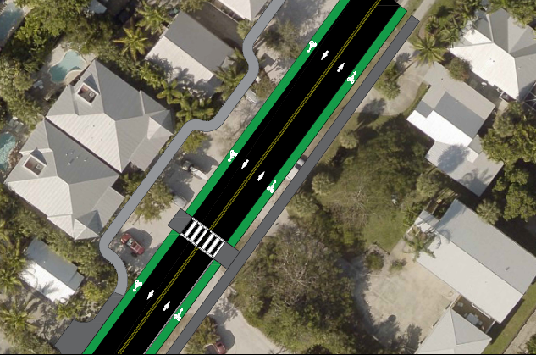
ALTERNATIVES #2
Add Buffered Bike Lanes and Sidewalks on Both Sides & Ped Crosswalks
Notes:
Antonio

Slide 29
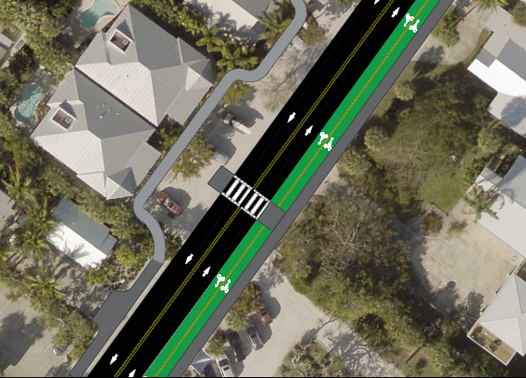
ALTERNATIVES #3
Add Multi-use Path, Sidewalks on Both Sides & Ped Crosswalks
Notes:
Antonio

Slide 30
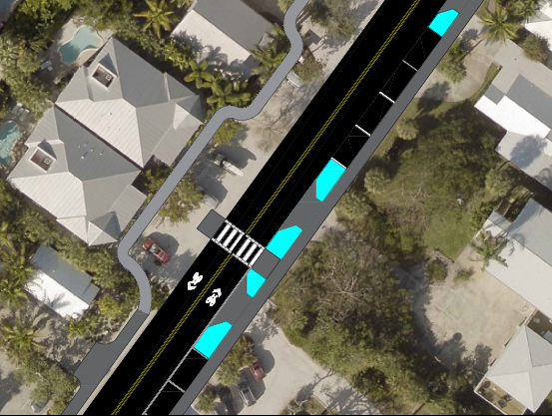
ALTERNATIVES #4
Add On-Steet Parking/Delivery Area, Sidewalks on Both Sides & Ped Crosswalks
Notes:
Antonio

Slide 31
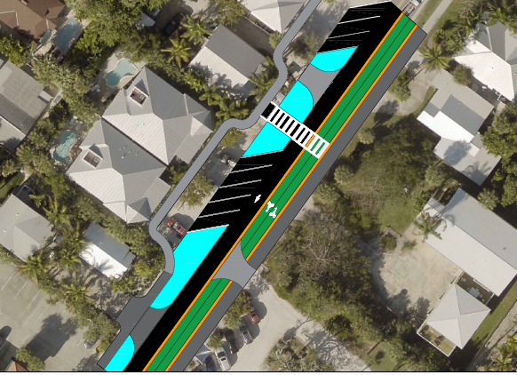
ALTERNATIVES 5A
Convert Pine Avenue and Magnolia Avenue as one-way streets, with Sidewalks, On-Street Parking/Delivery, Multi-use Path & Ped Crosswalks
Notes:
Antonio

Slide 32
IMPLEMENTATION SCHEDULE
Notes:
Gery

Slide 33
IMPLEMENTATION SCHEDULE
Alternative #1; Pavement Marking and Pedestrian Crosswalks
Design & Permitting - 2 -3 months
Construction – 4 months after design
Alternative #2; Add buffered Bike Lanes, Sidewalks and Pedestrian Crosswalks
Design & Permitting - 6 to 8 months
Construction – 12 to 16 months after design
Notes:
Gery

Slide 34
IMPLEMENTATION SCHEDULE
Alternative #3; Add Multi-use Path, Sidewalks on Both Sides & Ped Crosswalks
Design & Permitting - 8 - 12 months
Construction – 18 - 24 months after design
Alternative #4; Add On-Steet Parking/Delivery Area, Sidewalks on Both Sides & Ped Crosswalks
Design & Permitting - 8 - 12 months
Construction – 18 - 24 months after design
Notes:
Gery

Slide 35
IMPLEMENTATION SCHEDULE
Alternative #5; as one-way street, Sidewalks, On-Street Parking/Delivery, Multi-use Path & Ped Crosswalks
Design & Permitting - 8 - 12 months
Construction – 18 - 24 months after design
Notes:
Gery

